Slide 1
Parks on the Air (POTA) Program Overview
KEVIN CULP, KZ3L AND JACK KIBELBEK, N8EU
Presented to the NEWARK AMATEUR RADIO ASSOCIATION
APRIL 16, 2022

Slide 2
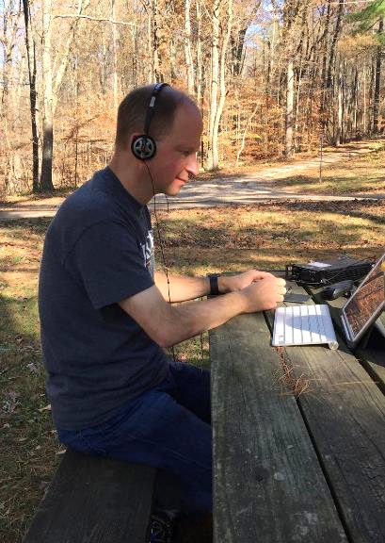
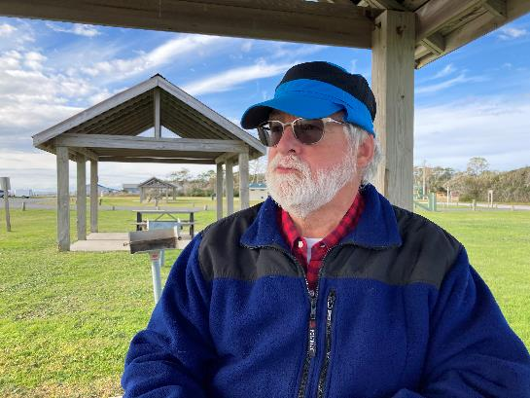
INTRODUCTION
Presenters
Kevin Culp, KZ3L
Licensed since 1983 – Amateur Extra Class since 1986
Primarily a CW & portable op
Currently the Ohio POTA Mapping Coordinator
32-year active duty Air Force career + civil service – Engineering / Occupational Health
Jack Kibelbek, N8EU
Licensed since 1969 – Amateur Extra Class since 2018
Primarily a CW op + portable QRP
Retired pediatrician

Slide 3
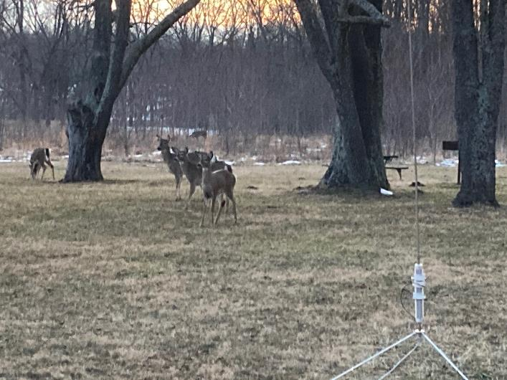
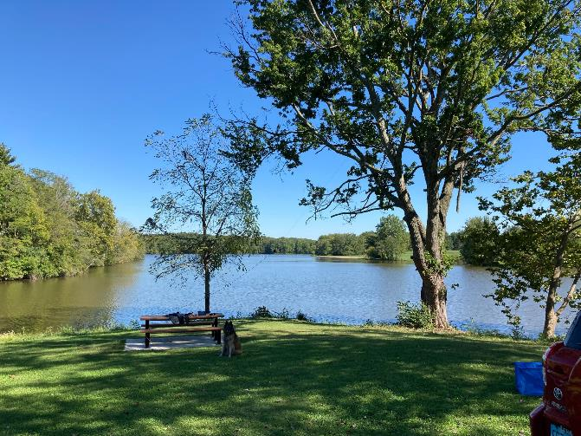
INTRODUCTION
What is Parks on the Air (POTA)?
A FUN, FUN activity! ← NOT a contest
Promotes portable amateur radio operations & enjoyment of our parks
Spend more on-air time (home or portable)
An awards program
Encourages communications “readiness”
Enjoy “field day” any day of the year!
No HOA restrictions or local electrical noise – HUGE DIFFERENCE!
Combine with other hobbies—disc golf, fishing, camping, hiking, boating, etc.

Slide 4
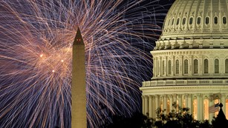
INTRODUCTION
Origin: ARRL’s National Parks on the Air (NPOTA) – 2016
Celebration of USA’s 100 year National Park history
POTA program began shortly thereafter
Started in US, now International
>9,000 parks in the U.S.
Numerous countries being added
Activators often feel like rare DX, even CONUS!

Slide 5
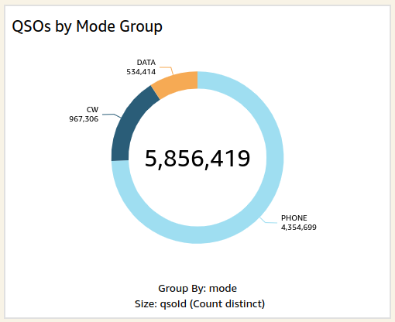
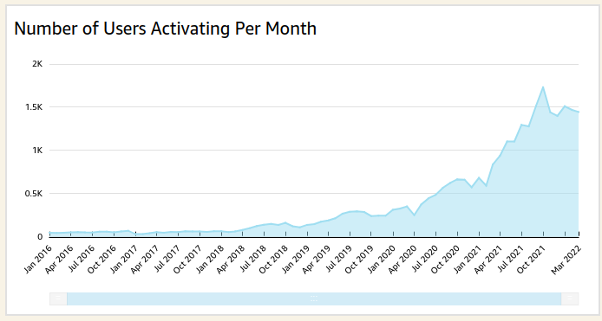
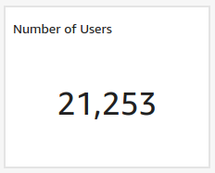

Slide 6
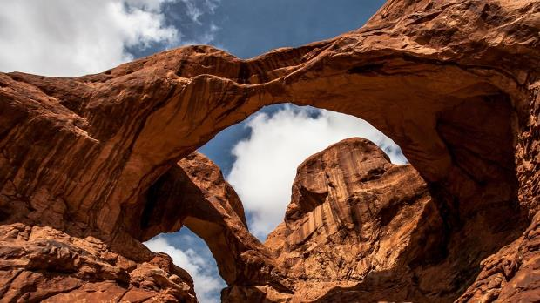
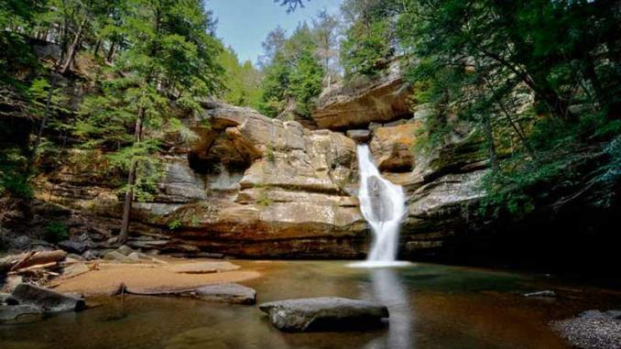
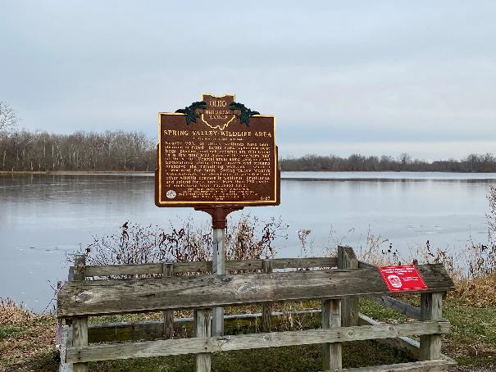
TERMINOLOGY
Park (a.k.a. “reference area”)
Federal- or State-owned and operated entity
Parks, sites, forests, preserves, refuges, wildlife areas, trails, etc.
MUST be listed in the POTA database to count (e.g. K-1940)

Slide 7
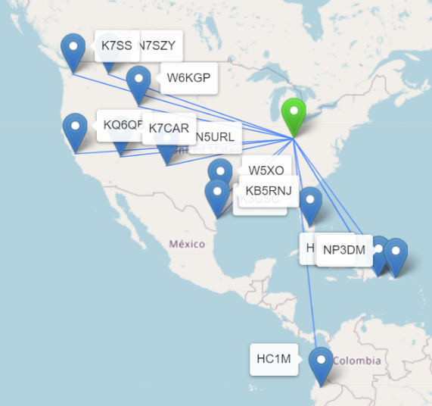
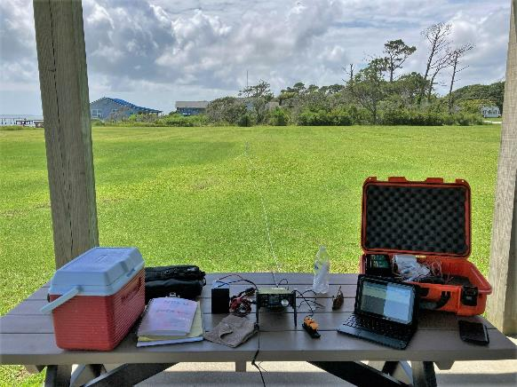
TERMINOLOGY
Activation
Station completes 10+ QSOs in any 24-hour UTC day from the park
Distinct QSO = band + mode + call
No specified exchange! ANY QSO counts (even contest QSOs)
Simplex only (except satellite)
No limit on # activations at a park
Activator
A station which activates a park
Must be located in the park (duh!)
Trail: within 100’, on public land

Slide 8
TERMINOLOGY
Hunter
A station which calls an activator
An activator can ALSO be a hunter; see below
Park-to-Park
QSO between two parks
Late Shift
Between the hours of 0000 and 1200 UTC

Slide 9
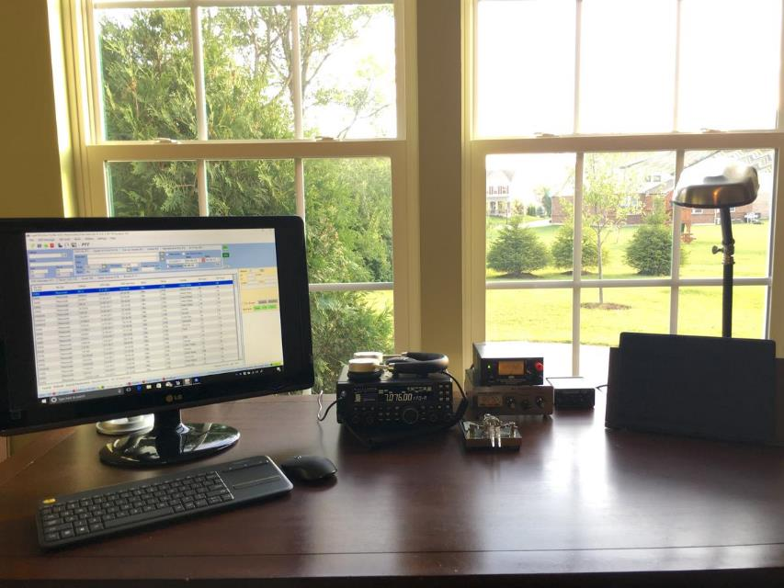
HUNTING A PARK
Most common way to participate
Without hunters, the entire program would FLOP!
Simplest way to learn about POTA
Call from anywhere, anytime (home QTH, mobile, another park)
Build list of parks and earn awards quickly!
Awards program is automatic – only activators submit logs to POTA
Get started: Register at http://pota.app

Slide 10
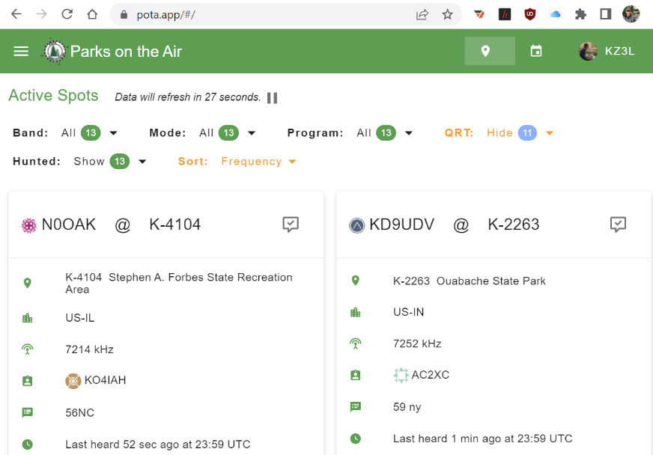
HUNTING A PARK
Check spots page--Best way to find activators (pota.app)
Tune up on empty frequency
Listen for call, QSO style & cadence
Announce your call 1x after CQ, QRZ?
Spot the activator on pota.app)
Breaking through pile-ups:
On CW, never zero-beat! TX slightly off freq (0.05-0.1 kHz)
On SSB, it’s tough… tail-ending is discouraged. Compression helps

Slide 11
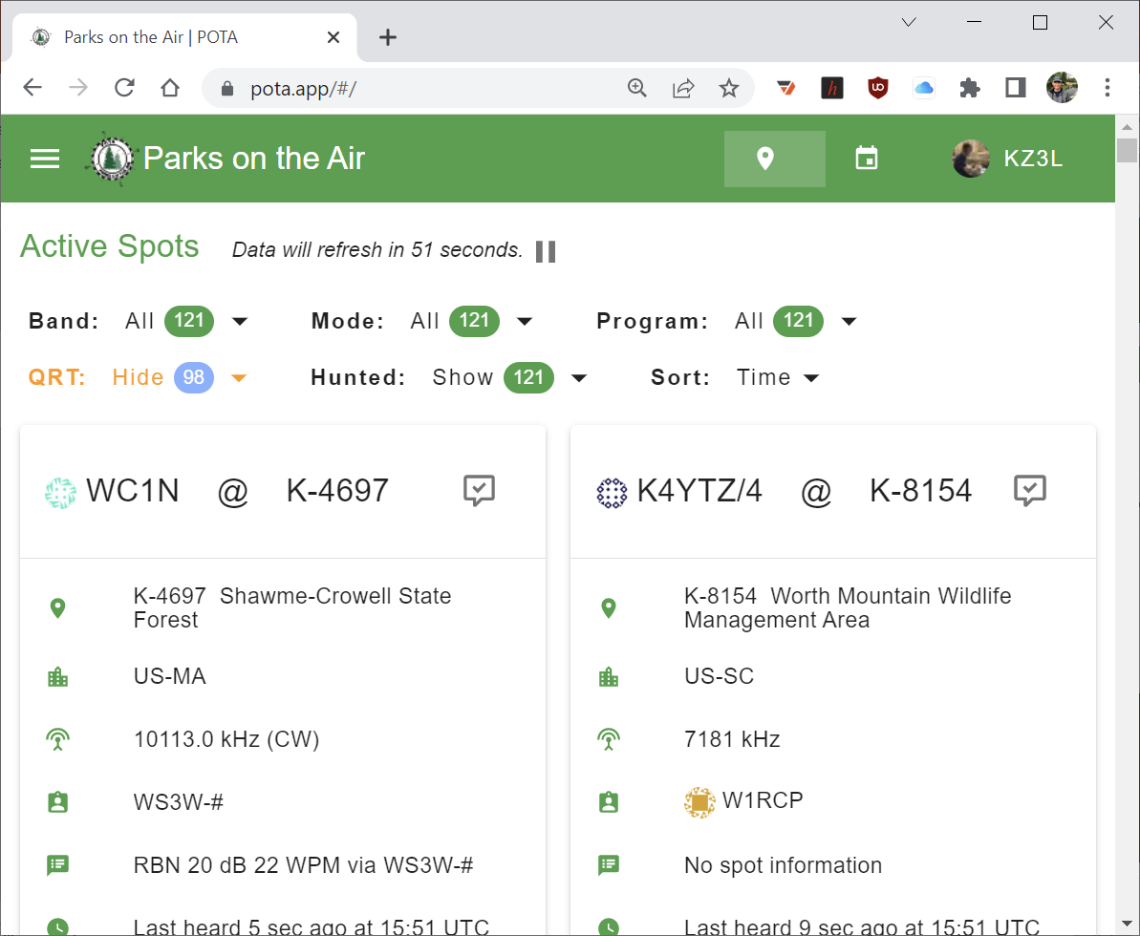
Spotting page
Filter by band & mode
Sort by freq or time
Log into your account to spot activators
Watch comments
“Last heard…”
QRT
Sig reports
Less common modes (FT4, FT8, etc.)
Refreshes automatically

Slide 12
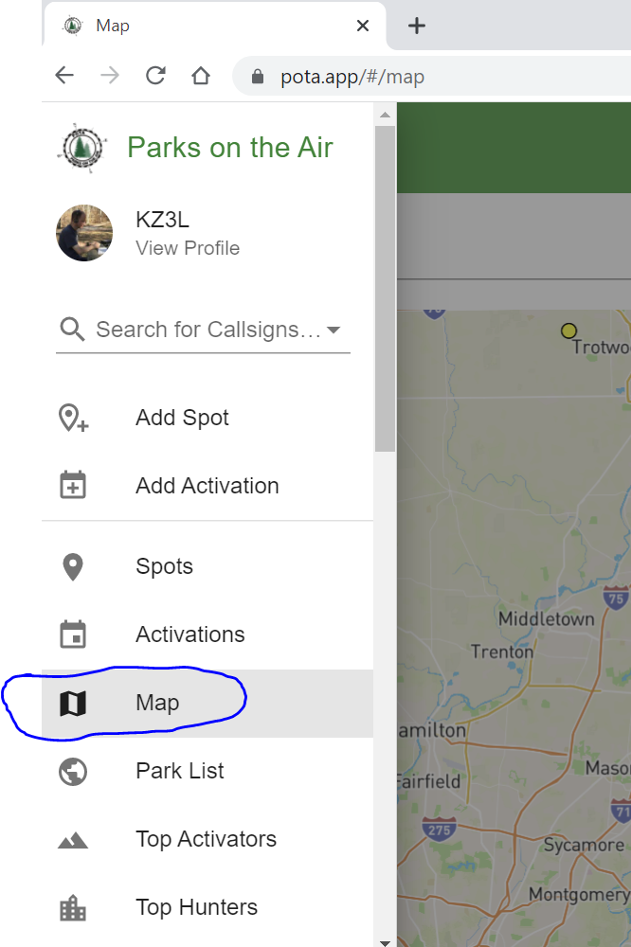
ACTIVATING A PARK
Register at http://pota.app
Read guides & FAQs at http://parksontheair.com
Selecting a park
Look on http://pota.app
Research geographic boundaries
Ohio: DNR GIS or Park Web Site https://gis.ohiodnr.gov/MapViewer/?config=ODNRLands
Know park rules (hours, limitations, access, parking, trails, etc.)
Check the official park web site https://ohiodnr.gov/go-and-do/plan-a-visit/find-a-property/find-a-property-search

Slide 13
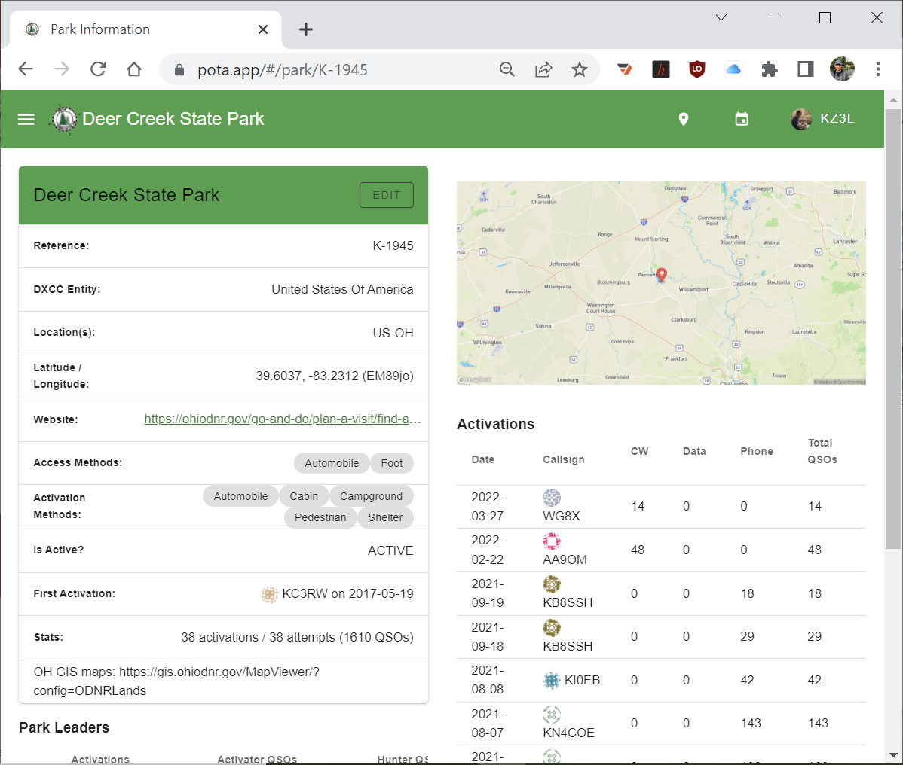

Slide 17
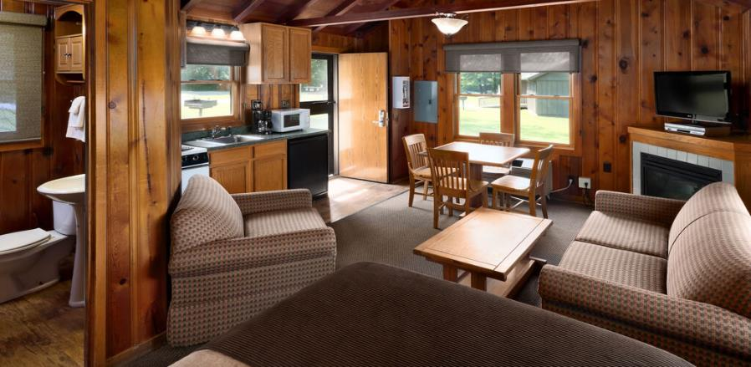
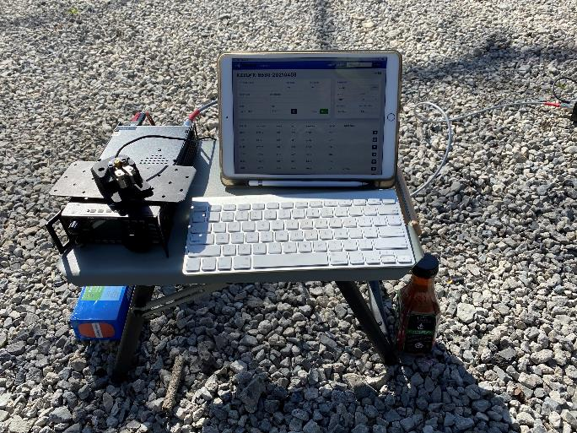
ACTIVATING A PARK
What’s your style?
Extremes:
All the comforts of home – lodge/cabin?
Hike-in activation
Very common:
Bring your own shelter, tent, or canopy
Use existing infrastructure
Set up your own table & chair
Activate from inside the car

Slide 18
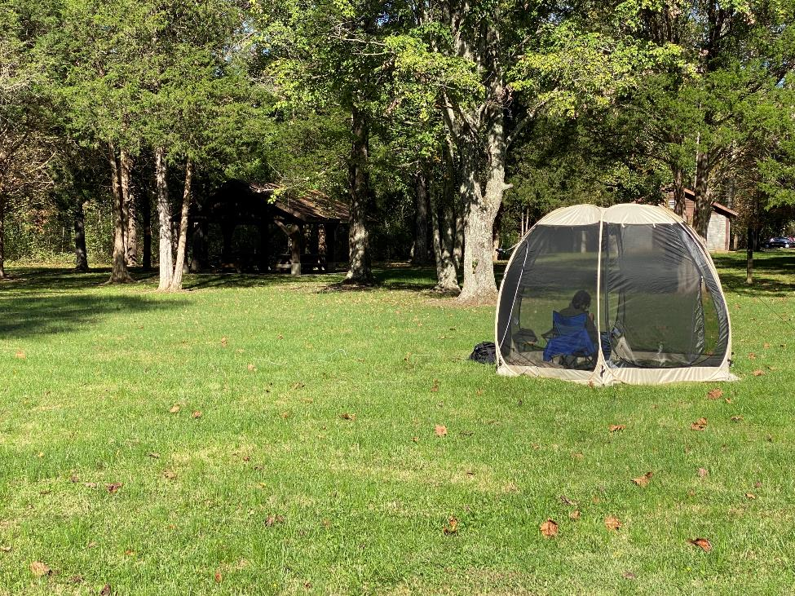
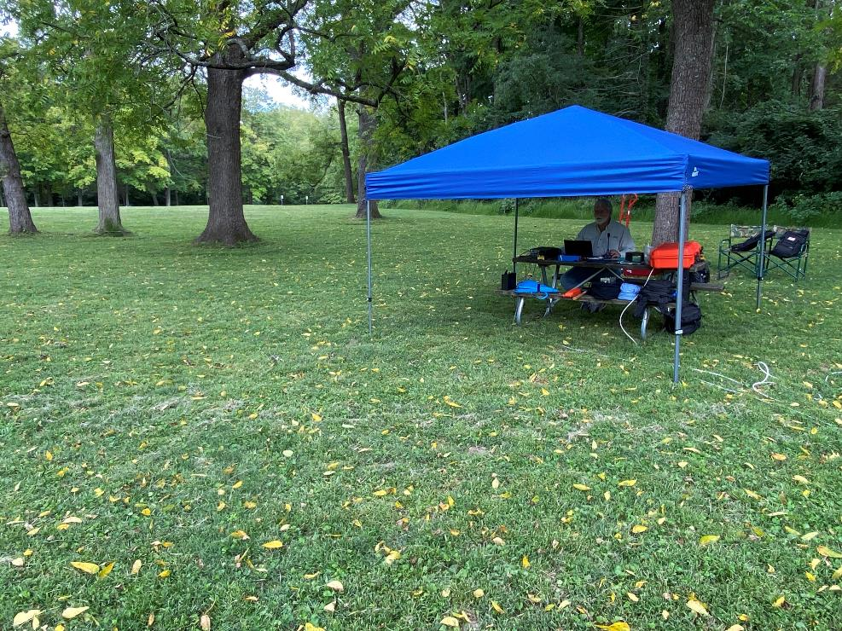

Slide 19
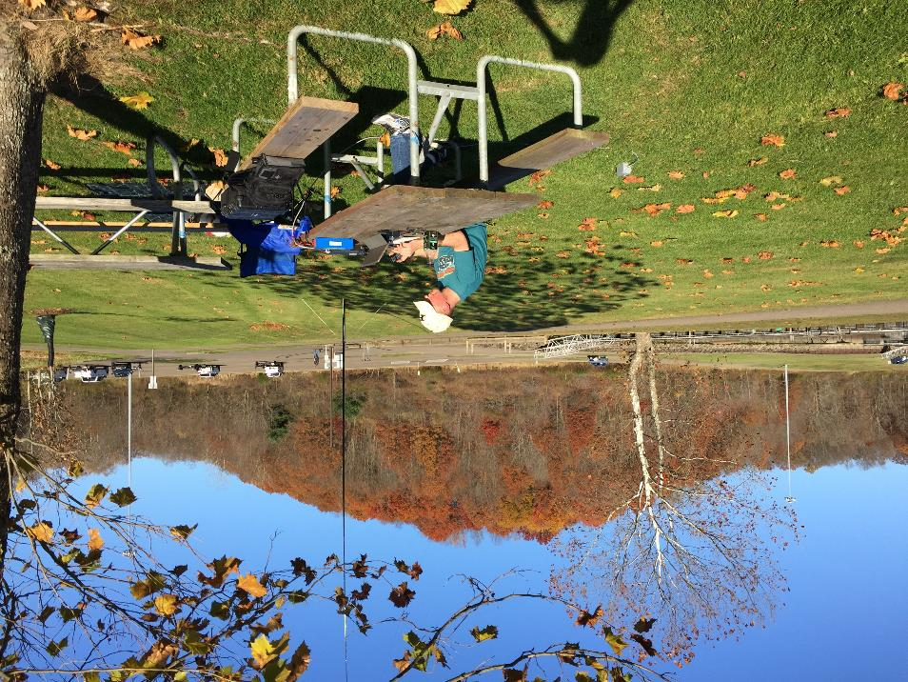
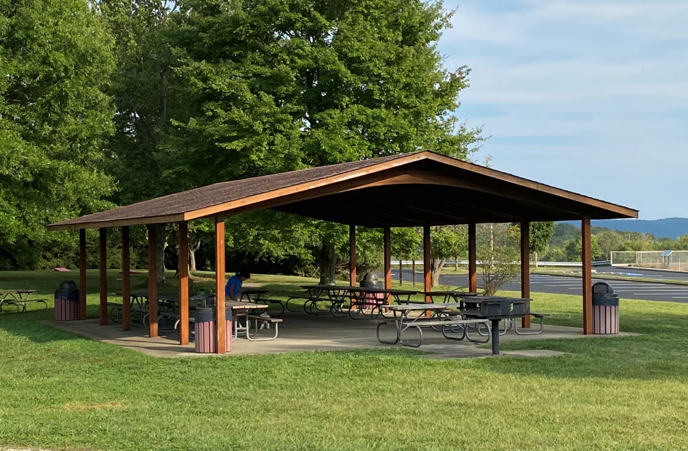

Slide 20
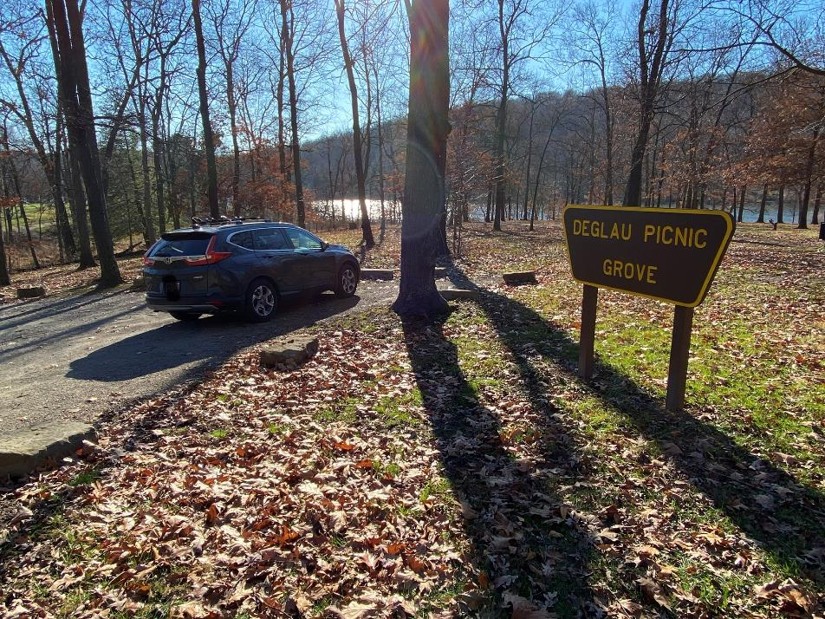

Slide 21
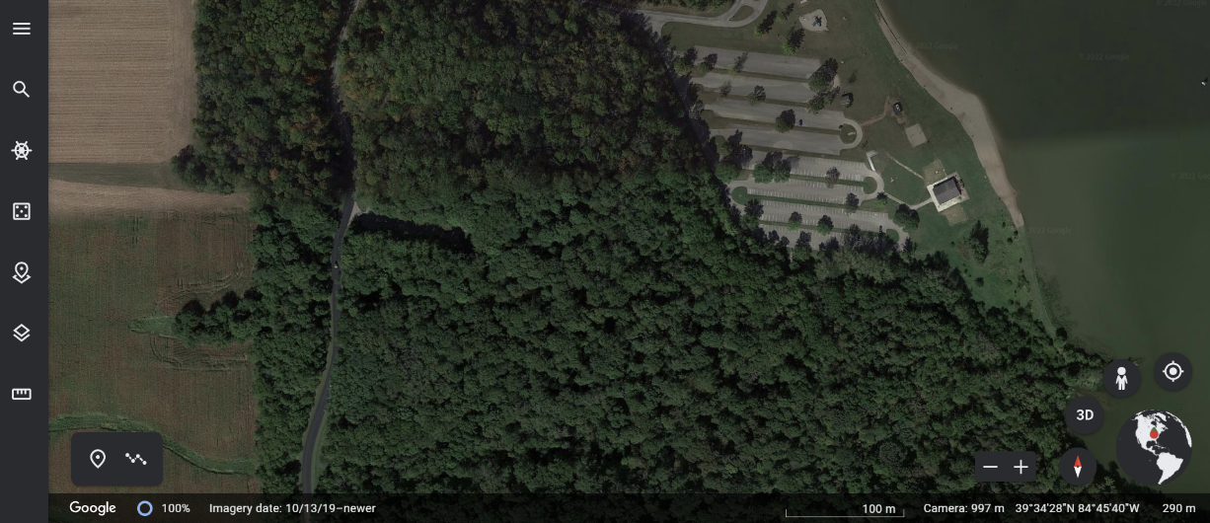
ACTIVATING A PARK
Where in the park?
Use maps, Google Earth, etc.
Trees vs. open field vs. parking lot
Facilities (you know what we mean)
Other park users
Elevation
The view

Slide 22
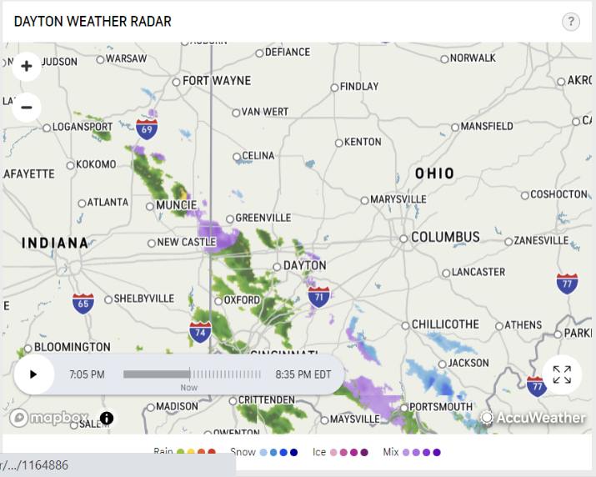
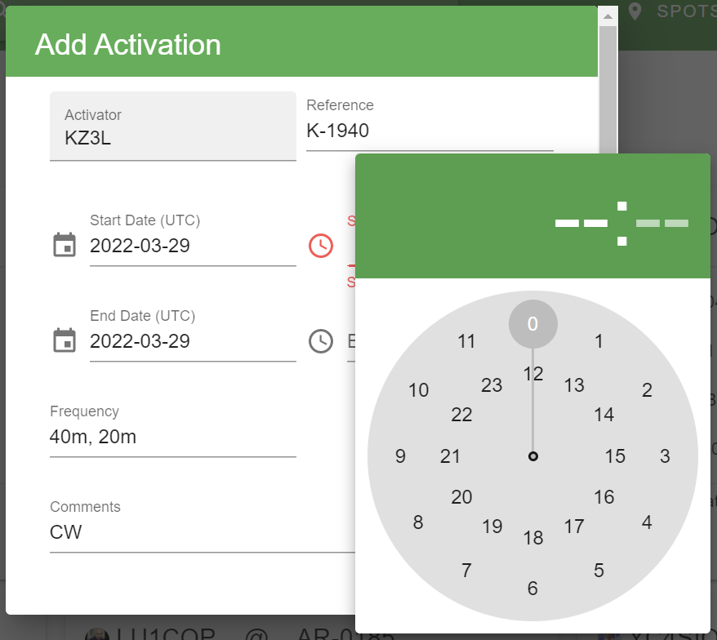
ACTIVATING A PARK
Before you go
Do your planning!
Check weather, prop forecast, etc.
Document Park # and County
Inventory and triple-check equipment
Dead battery? Missing coax?
Schedule your activation on http://pota.app (optional)
Reverse Beacon Network can help to spot you – CW or Digital
Hunters can look for you

Slide 23
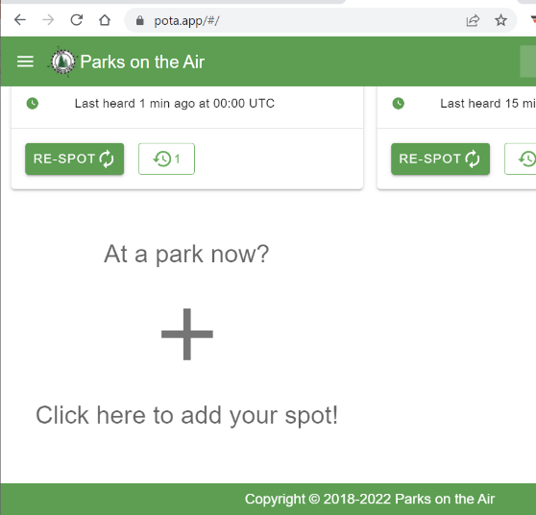
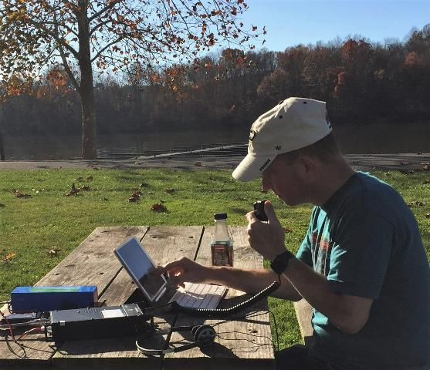
ACTIVATING A PARK
Select a band: All bands are fair game (incl WARC)
Spot Yourself on http://pota.app
Calling CQ
Listen, then QRL? Is this freq in use?
“CQ POTA… from [call] at Park K-####”
Typical Exchange
Call, state, and RS(T) report
There is no required exchange
Tradition: Give priority to “Park to Park” (or “P2P” on CW), “QRP”, and “Mobile”
CALL OTHER PARKS! (P2P)

Slide 24
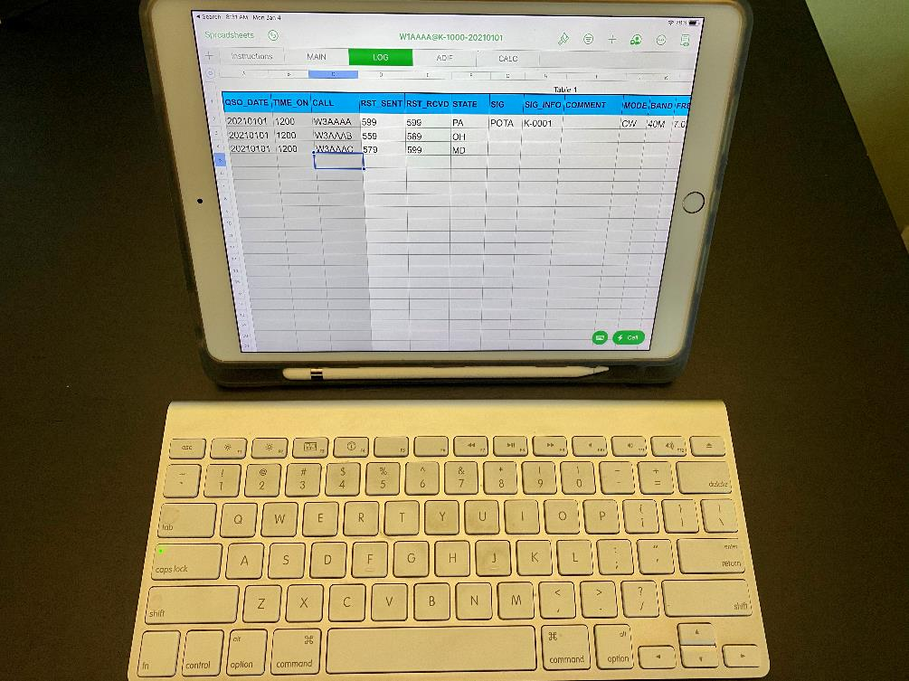
ACTIVATING A PARK
Logging
Date & Time (UTC)
Your call
Their call
Band (freq not req’d for POTA, but helpful for other logs like QRZ and LoTW)
Mode
Their park # (optional)
Avoid dupes if activating multiple parks

Slide 25
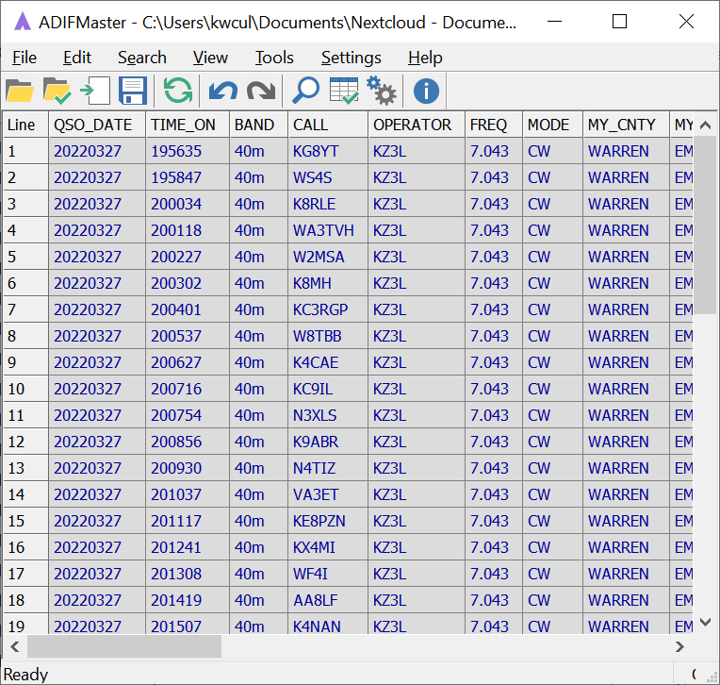
AFTER ACTIVATION
Repack/refresh/recharge
Leave park better than you found it
Finalize log & submit to POTA
Triple check logs before sending
ADI File (ADIF) format ONLY
File name = call@K-####-yyyymmdd
Add state if park spans multiple
Send to K#@parksontheair.com (# = your call sign #)
Coordinators are volunteers – might take 3-4 wks for log to appear in stats

Slide 26
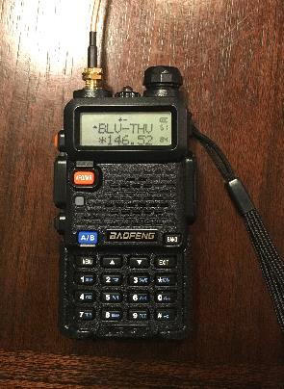
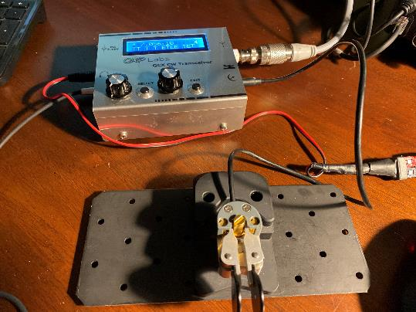
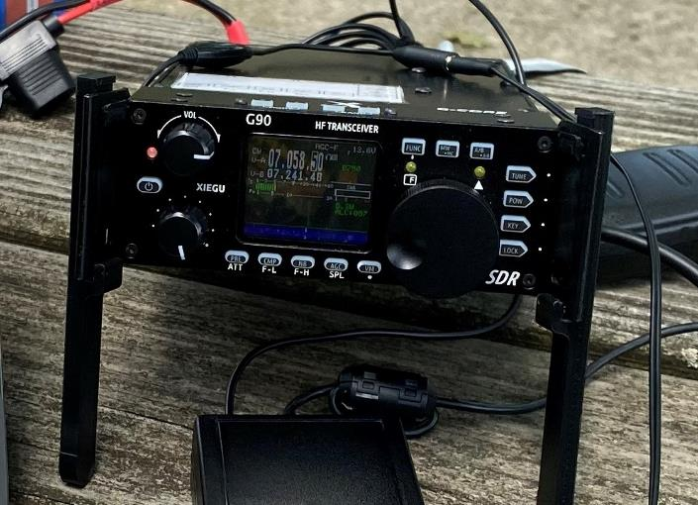
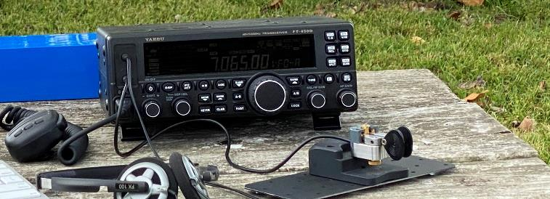
PORTABLE EQUIPMENT
Radio
HF most common
May use VHF/UHF if desired
No repeaters
Satellite/ISS allowed
Adjust to your operating style
Hiking in? Go lite!

Slide 27
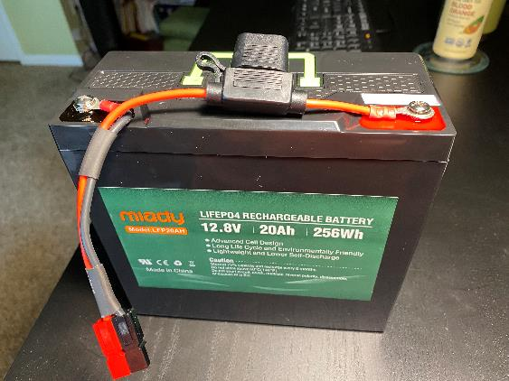
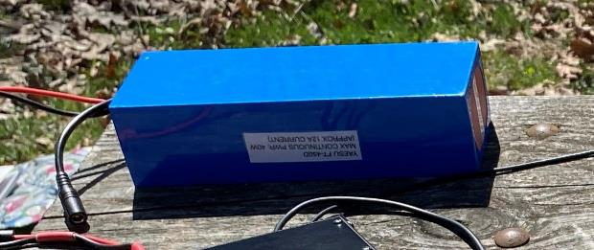
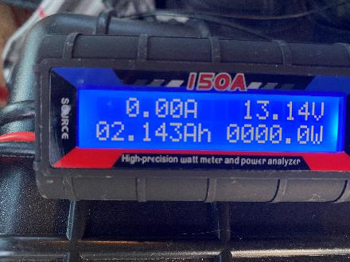
PORTABLE EQUIPMENT
Power
Anything goes, even available 110AC
Gas generator probably excessive
Batteries most common
LiFePO4 light w/~80% usable capacity
Rough rule of thumb: 5Ah/hr/100W power setting
12 Ah LiFePO4 good for ~1:45 - 2 hrs
Cut power in half = only 0.5 S-unit loss
Measure use w/in-line power meter
Anderson PowerPoles a good choice

Slide 28
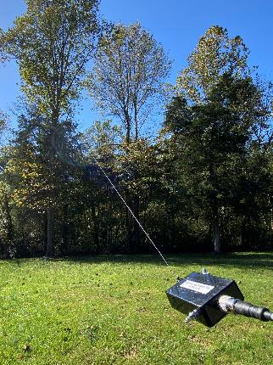
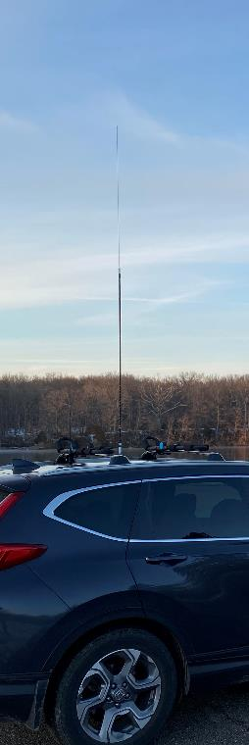
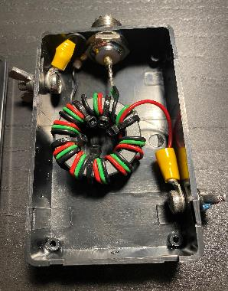
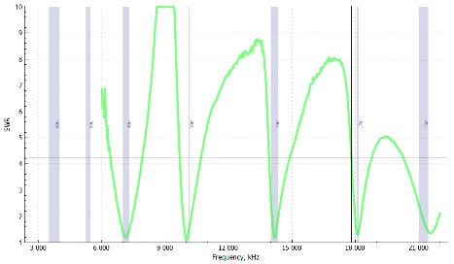
PORTABLE EQUIPMENT
Antennas
NUMEROUS options!
Adapt to location and style
Consider support structure (self-supporting, trees, in car)
Low power? Resonant is best choice
Common choices:
End-Fed Halfwave or “Random”
Dipole / inverted vee
Multiband vertical

Slide 29
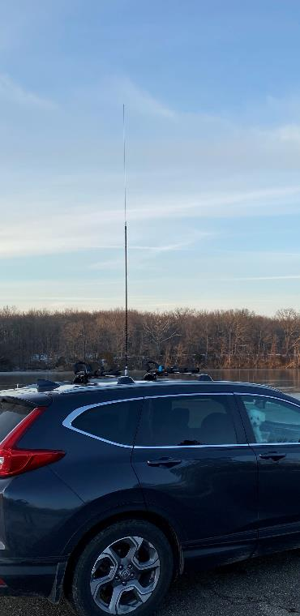
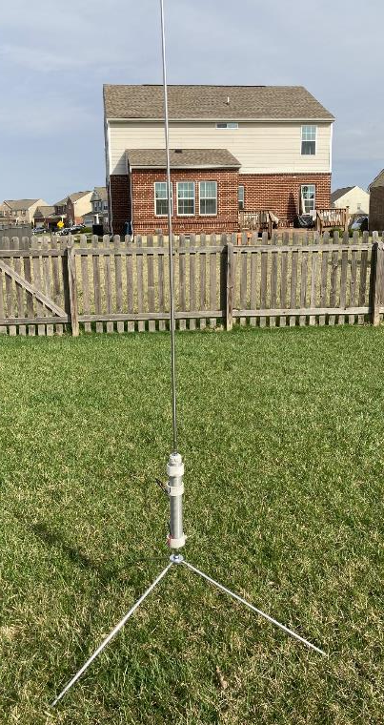
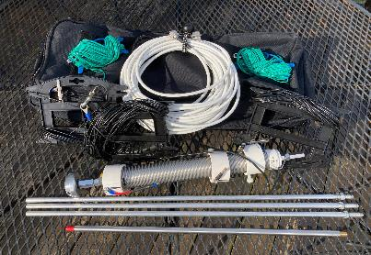
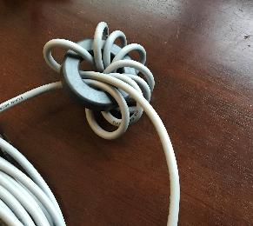
PORTABLE EQUIPMENT
Antennas
Common choices (cont.):
Coil-loaded, such as the Wolf River Coil products
Hamsticks (don’t underestimate!)
Feedline
Coax most convenient
Short runs (<50’) = low loss
Feedline choke may help w/stray RF
Not always needed (feed directly from radio)

Slide 30
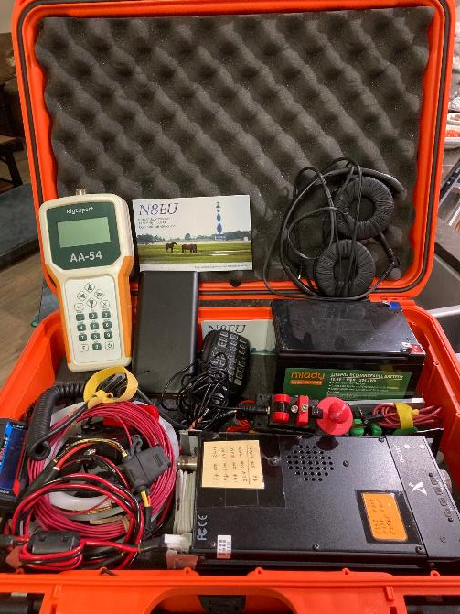
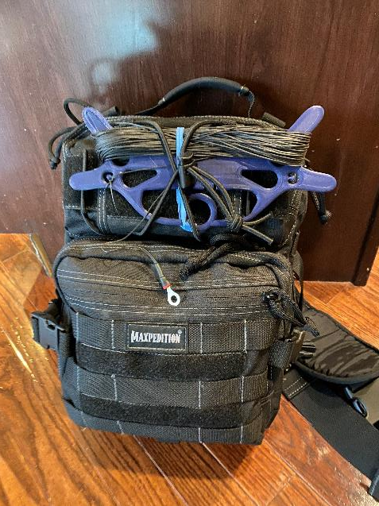
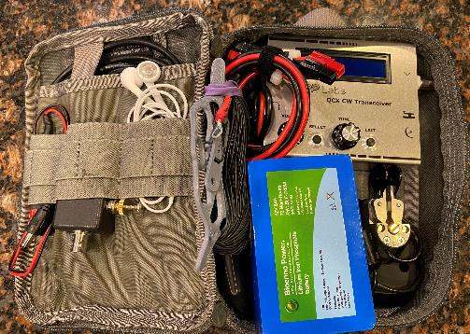
PORTABLE EQUIPMENT
Cases / transportation
Hard case
Soft case / backpack
Economize!
Hiking? Small kit can fit in a fanny pack!
All other accessories
Cables, connectors, spare cables, tools, tape, zip ties, headphones, mic, key
Personal care items
1st aid kit, bug spray, sun screen, gloves/hat, food, water, towels

Slide 31
PORTABLE EQUIPMENT
Pro tips
Arborist throw line, rope, and weight – great way to get antenna in a tree (50-70’)
Use kite winders (“figure 8”) to store wire antennas
“Over-under” method for coax, bundles of radials, etc.

Slide 32
LOGGING SOFTWARE
Your choice!
Be sure it generates ADI file with needed fields
Common Options:
N3FJP’s AC Log (Windows)
HAMRS (All platforms)
N1MM Plus (Windows)
RUMLog (Mac/iOS)
Custom spreadsheets
FLE - Fast Log Entry
ADIF Master (great to check ADIFs)

Slide 33
AWARDS
Automated – based on activator log
Numerous – for activators & hunters
# parks, # activations, # park-to-parks, repeat activations/hunted, “kilo,” multiple parks/day, 10-band, etc.
Thresholds start early and build (10, 20, 30, 40, 50, 75, 100, 500, 1000…)
Download from pota.app
May take 1-4 weeks to appear
Excellent progress tracker

Slide 35
SPECIAL TOPICS
Handling Nets and QRM
Always take the high road!
No one “owns” a freq, but be a good ambassador for the program
Deliberate QRM does happen
Contests: Can’t beat ‘em? Join ‘em!
Or go to WARC bands or other modes
http://contestcalendar.com
Always submit logs! Hunters want parks

Slide 36
SPECIAL TOPICS
Multi-Op activations
Share the mic or key
Ops all get POTA credit
Follow FCC ID rules
Submit separate logs
Simultaneous
Operate on different bands
Separate antennas from each other as far as practical
Use band-pass filters

Slide 37
Special Topics
Multi-Park activations
“two-fer,” “three-fer,”…
Park-within-a-park
In a park and w/in 100’ of trail
Any combination of above
Every QSO counts for each park
Submit separate logs for each park

Slide 38
GETTING STARTED
Register at http://pota.app
Visit http://parksontheair.com
Read FAQs and guides
Watch videos
Practice hunting & listen to other activators
Join POTA Facebook Group and Slack channel – great communities!
See info on http://parksontheair.com
HAVE A HAM GOOD TIME!!!

Slide 39
Questions?
KEVIN CULP, KZ3L – KZ3L@ARRL.NET
JACK KIBELBEK, N8EU – JACK45458@YAHOO.COM

