Slide 1
JT65 & JT9 Digital Modes on HF
Kevin Culp
KZ3L
Feb 23, 2017

Slide 2
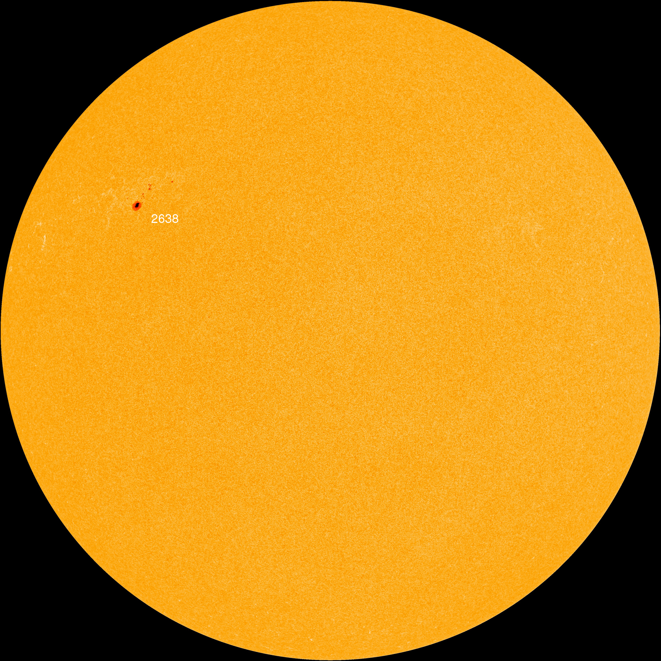
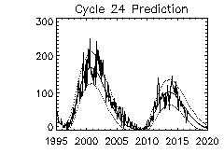
Sun Spots = Propagation
Spotless Days: 2017 total: 11 days (22%)* 2016 total: 32 days (9%) 2015 total: 0 days (0%) 2014 total: 1 day (<1%) 2013 total: 0 days (0%) 2012 total: 0 days (0%) 2011 total: 2 days (<1%) 2010 total: 51 days (14%) 2009 total: 260 days (71%)
* As of 23 Feb 2017
Our sun on
Feb 23, 2017

Slide 3
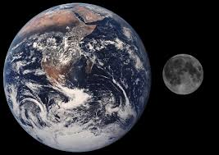
What Are JT65 & JT9?
Developed by Joe Taylor, K1JT
Protocol for extremely weak signals
Originally optimized for Earth-Moon-Earth (VHF)
Great during sunspot minimum
Error-correcting features
Plain text message: max 13 chars
"The Musical Mode"

Slide 4
What Are JT65 & JT9?
Audio Frequency Shift Keying (AFSK)
JT65 = 65 tones; JT9 = 9 tones
One-minute TX/RX sequences
TX/RX: t = 1 sec to t = 47.8 sec
Decoding occurs in remainder of each minute
Requires precise time sync w/UTC
Low power/full duty cycle
Usu. 5-20W; don't burn up your rig!

Slide 5
What is a QSO?
Communication between two or more parties
Minimum content?
Call signs
Signal report

Slide 6
QSO Format
Meets minimum QSO (call, sig report -dB, grid)
(1) CQ KZ3L EM58
(2) KZ3L F1ABC JN16
(1) F1ABC KZ3L -06
(2) KZ3L F1ABC R-13
(1) F1ABC KZ3L RRR
(2) KZ3L F1ABC 73

Slide 7
Standard Frequencies (USA)
JT65:
3.576 MHz
7.076
14.076
21.076
28.076
JT9:
3.578 MHz
7.078
14.078
21.078
28.078

Slide 8
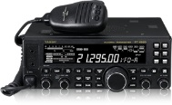
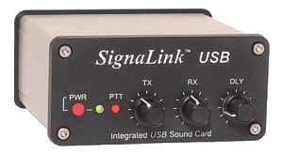
Hardware
Computer
(PC or Linux)
Sound card (internal or external)
Rig

Slide 9
Software
Reliable time sync program (I use "Dimension 4")
WSJT-X (my choice), JT65-HF, MultiPSK
Optional:
JTAlert-X –Notification of unworked stations; integrates with other programs to log QSO
Logging software (my choice: Log4OM)
Rig control software
Remote access software

Slide 10
Links
Dimension 4: http://www.thinkman.com/dimension4/
WSJT-X: http://physics.princeton.edu/pulsar/k1jt/wsjtx-doc/wsjtx-main-1.5.0-rc2.html#MAKE_QSOS
JTAlert-X: http://hamapps.com
Log4OM: http://www.log4om.com/dl/

Slide 11
Demonstration

